Slide 1
Innovation Fund First stage of the large scale call Application procedure
Marc Vanderhaegen
HoU, INEA
Notes:
This presentation will show how to navigate the funding and tender portal; how to prepare a presentation; how to fill in the necessary forms and create a consortium if needed; how to submit and update a proposal; how to find help in case of need; how to retrieve the proposal once submitted and how to update it upon need.

Slide 2
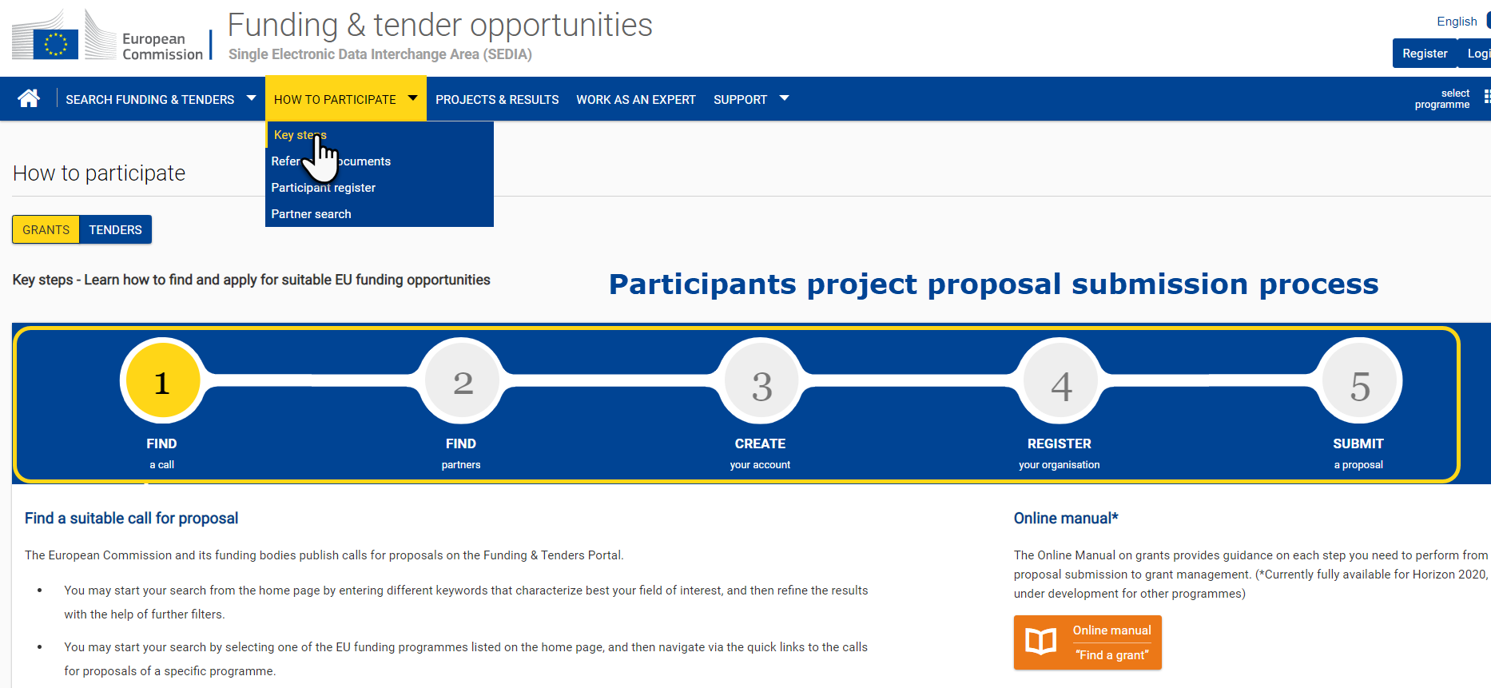
How to Participate general Help Page
Notes:
Some applicants for the Innovation Fund calls might be already familiar with EC grants. For the others you are first encouraged to the « How to Participate » section of the funding and tender portal, that will already answer a lot of questions

Slide 3
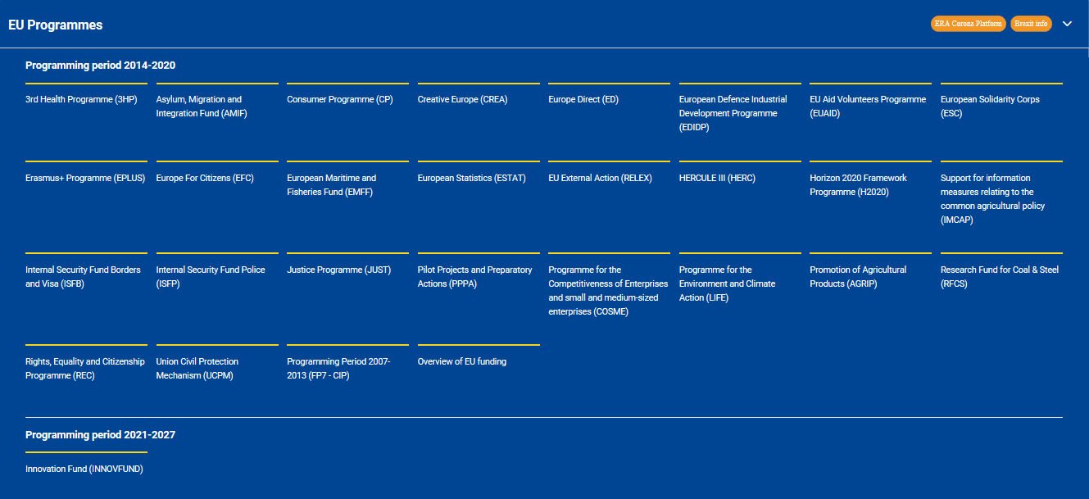
Where to Find the Innovation Fund
https://ec.europa.eu/info/funding-tenders/opportunities/portal/screen/home
Notes:
The Innovation Fund can be found in the F&TP Home Page
CLICK. At the bottom of the list of programmes – clicking on this takes you to the programme landing page
It is labeled 2021-2027 because it is not covered by the current MFF but this is purely cosmetic.
You see here the benefits of having the IF with the other numerous programmes managed by the EC centrally. Among the ones present on this page the Horizon 2020 framework programme and the LIFE programmes are of potential interest.
Many more programmes are being centrallised currently in this tool (around 17) of which the CEF programme that might also prove interesting for IF stakeholders in the future.
If you are interested to find funding opportunities beyond the innovation fund, do searches from this page of the portal. Type in hydrogen for instance and all calls open to hydrogen solutions will appear (including the IF).

Slide 4
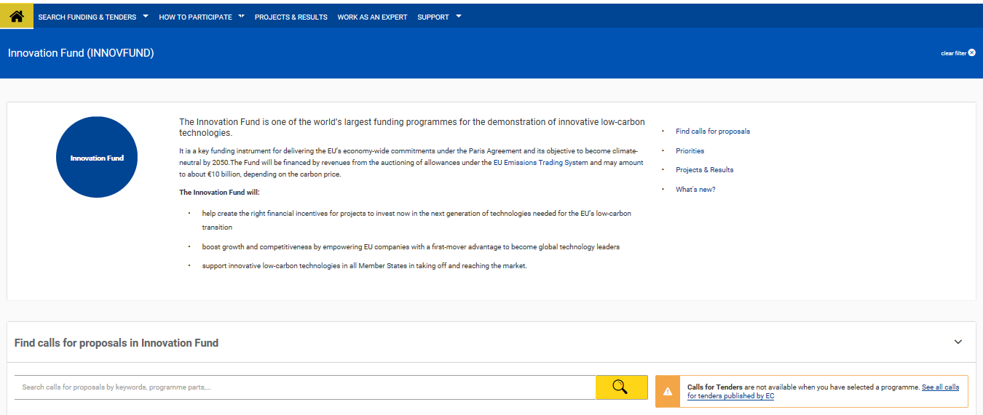
Innovation Fund Landing Page
Notes:
The programme landing page is the easiest route to applying for the call. CLICK. Just click the search button to see to the available call. As the programme is just starting this landing page does not contain a lot of information; however as time passes information on calls; news; projects, etc will be fed in this page.
Note the news section where information on the calls (any updates of the open calls and announcement related to the small scale call) will be published.

Slide 5
Call Search Page
Notes:
There’s just the one Ifund call for the moment. CLICK. Click the « Innovation Fund Large Scale Projects » to get to the call itself

Slide 6
Overview of IF Call Page
-Topic conditions and documents (most important section with call text)
-Short topic description
-Section to start a submission
-FAQs
-Get support
-Call information
-Call update
Notes:
All the information necessary for applicants is contained in this call page.
In principle there is no other place where relevant information should be found.

Slide 7
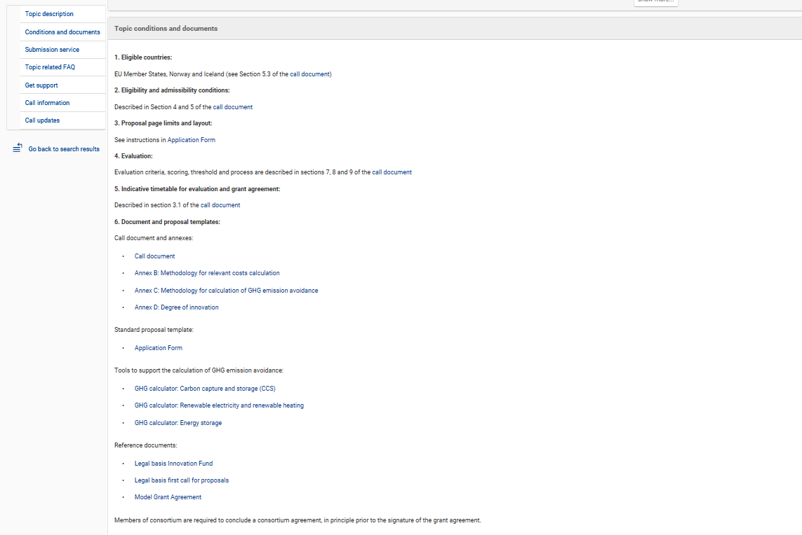
IF call page: Topic conditions and documents
Notes:
This is the most important section of the page as it contains all the relevant documents that applicants should read before starting a submission.
Of course the call text is the prime document; but please also have a look at the application forms before starting to start your submission.
Note the presence of the annexes B and C. The annex B is as an information as there is no requirement to have a detailed costs calculation at first stage. The annex C on GHG needs to be used mandatorilly to calculate the GHG saved by the projects and presented in the first criterion (CLIMA to further detail this).
Note the presence of GHG calculation tools. These are not mandatories documents to be used but strong encouragement to look into them and use them. CLIMA to further explain this.
Reference documents in particular the MGA to see how projects are supported if funding is granted.

Slide 8
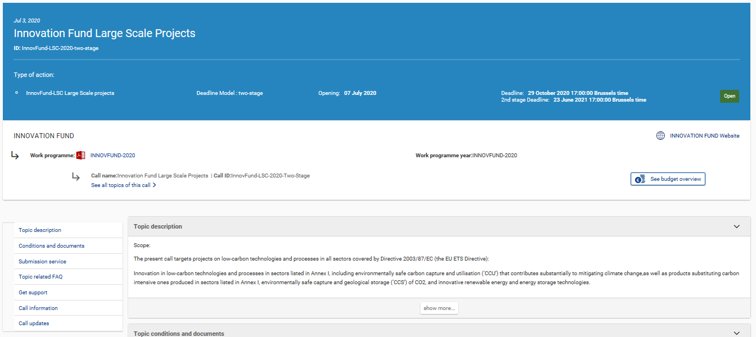
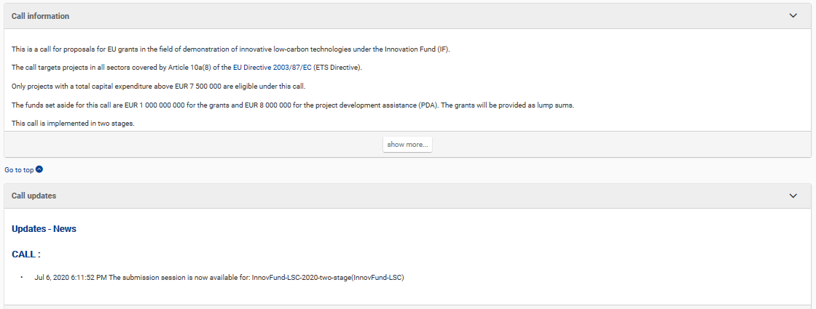
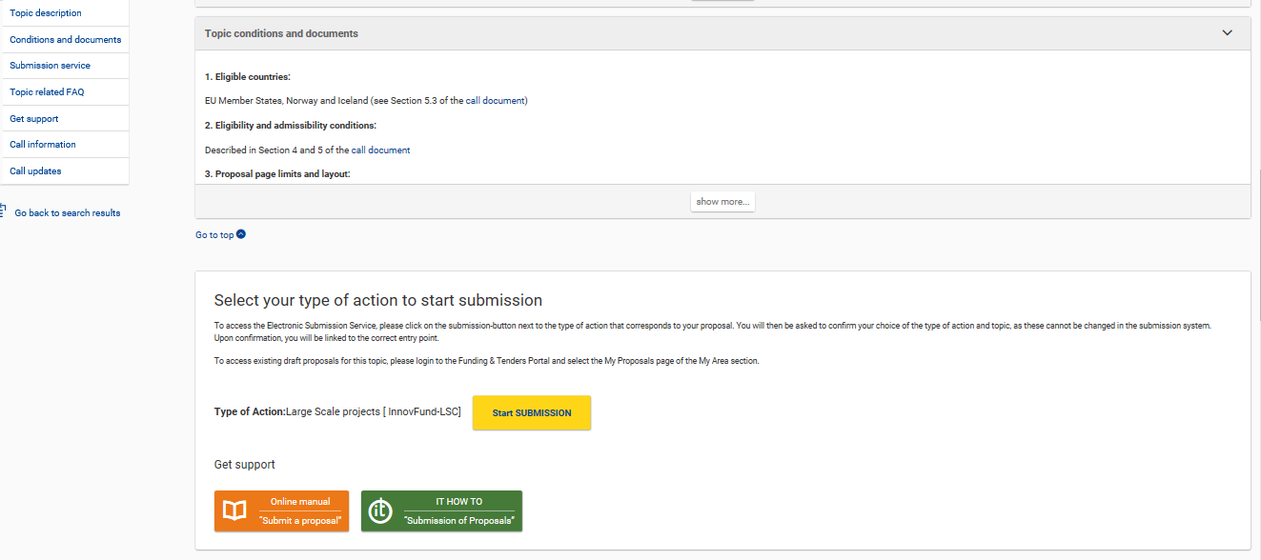
IF call page: other elements
Notes:
On the call page you get access to:
CLICK. A short topic description as an introduction to the call
CLICK. The topic conditions which I just detailed (previous slide). And the links to start the submission.
CLICK. The FAQs and the Helpdesk functions.
CLICK. The Call information and the call updates where any relevant information will be displayed.
CLICK. Click the « Start SUBMISSION » to begin creating a proposal
To create a proposal you need to have an EU Login account – if you have one already, login with those credentials, if not, you will be prompted to create one.

Slide 9
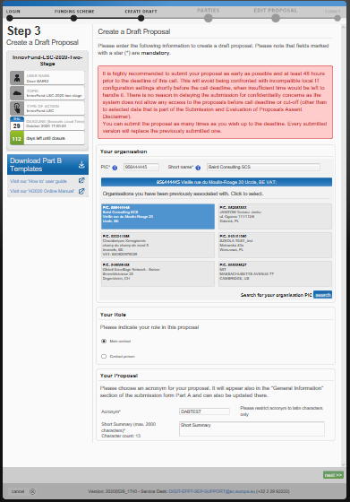
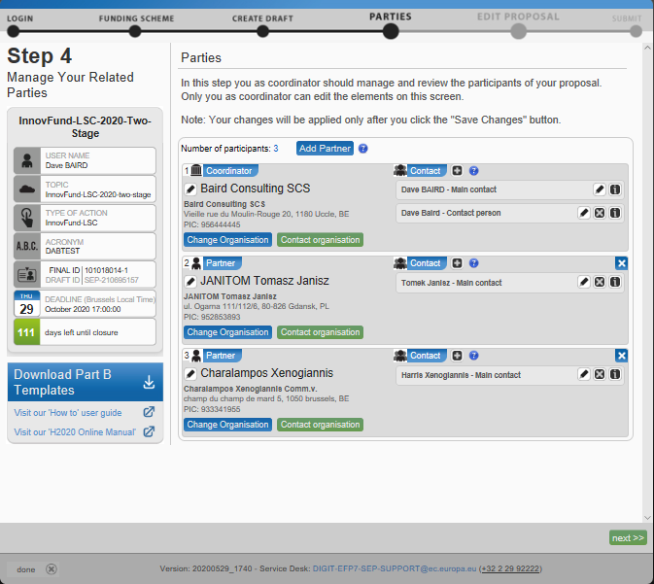
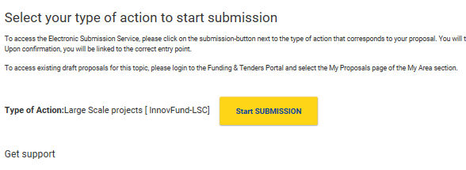
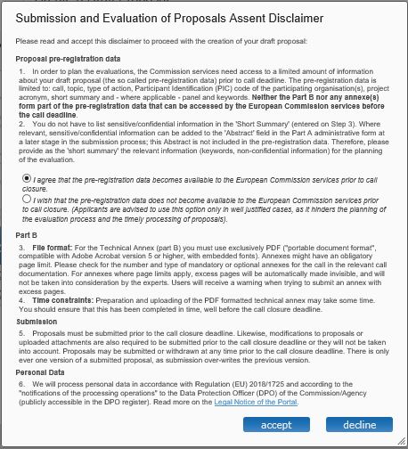
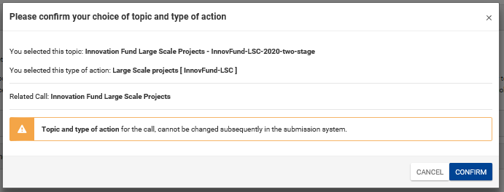
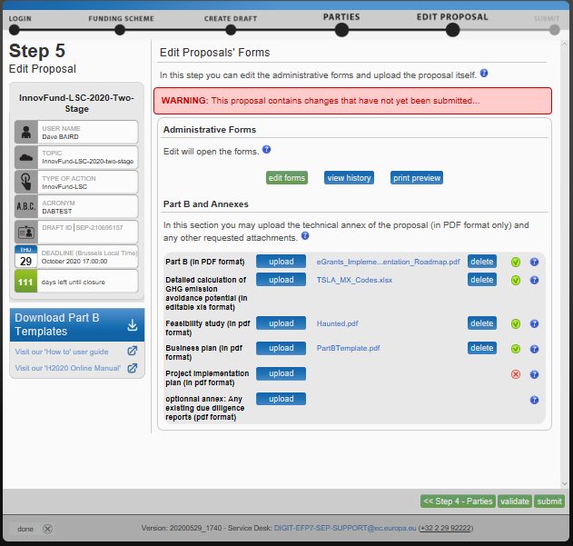
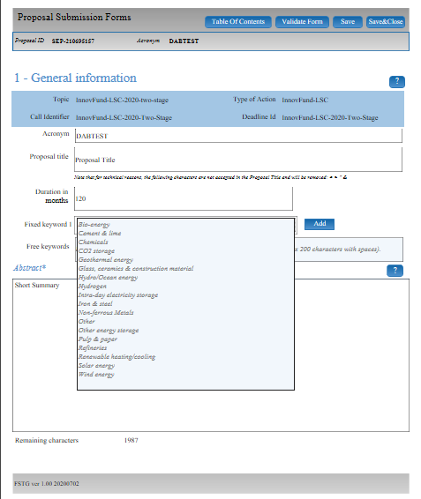
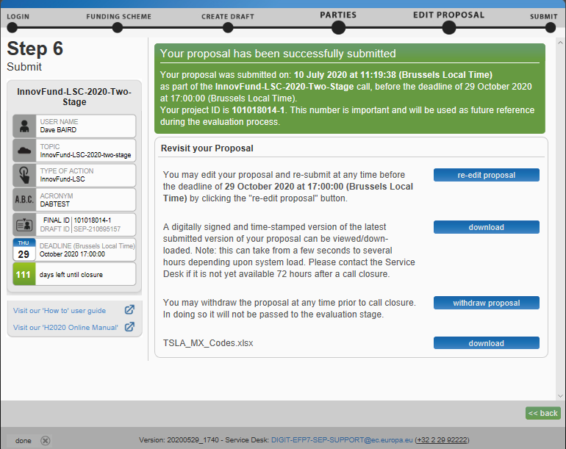
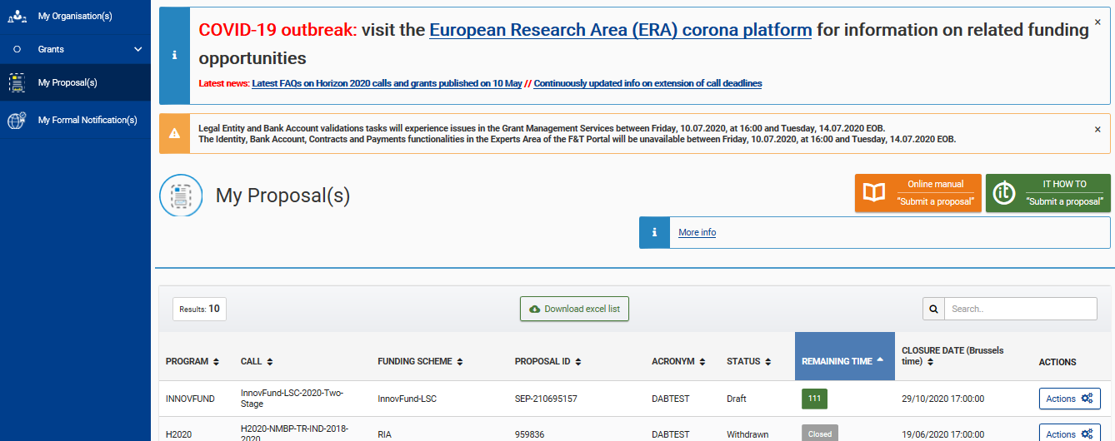
Submission Cycle in 6 steps
3) Create Proposal
4) Consortia Setup if relevant
1) Call and topic Selection
3 bis) Disclaimer
2) Call and topic Selection
5) Upload Proposal & Annexes
5 bis) Complete administrative data
6) Submit
My Proposals
Notes:
Once a draft proposal is created, it can be modified and submitted multiple times before the call deadline.
CLICK. Each submitted proposal overwrites the previous version, only the last one is retained. Recommended that applicants submit a first version of their proposal in good time before the deadline as it can be updated and refined, but late submisison, after the 17:00 deadline is not possible = DON’T LEAVE IT UNTIL THE LAST MOMENT!!
Proposals are retrieved from the « My Proposals » TAB, which you get access to when you log into the F&TP with your EU Login credentials
The system is collaborative, participants in your project (if you have a consortium) receive an invitation to the proposal and they can see the consortium, the uploaded annexes and the structured form – they can adapt their organisation details in the Part A form, if the coordinating partner allows it, but they cannot make changes to the consortium structure or upload annexes (this is only for the coordinator).
This is an overview of the submission cycle so no need to spend too much time here. Important to show that indeed applicants can go back to consortium setup and upload proposal and annexes steps at any time.

Slide 10
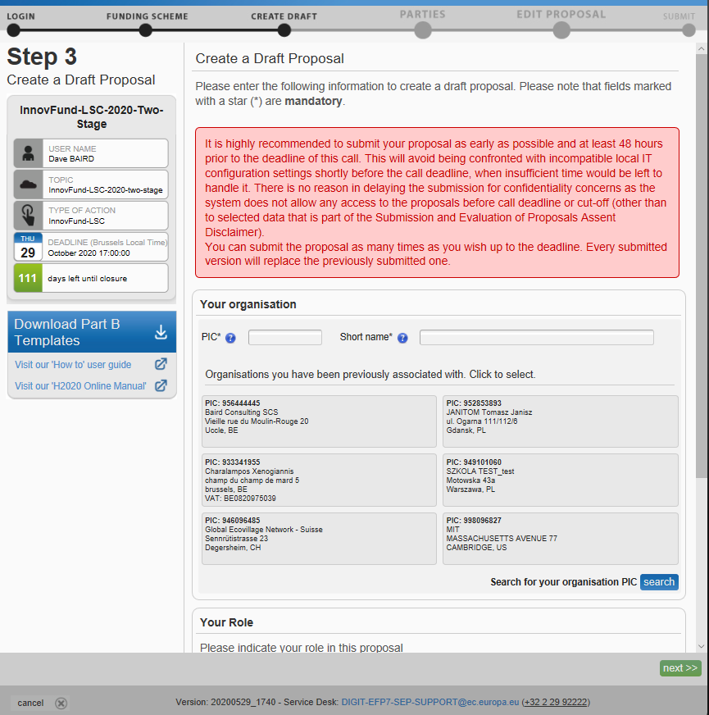
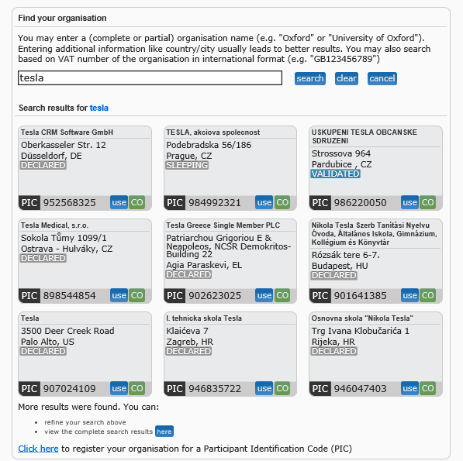
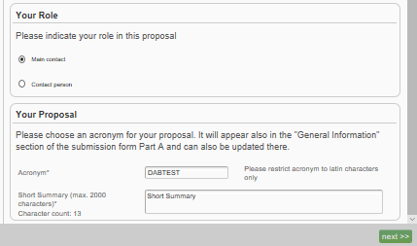
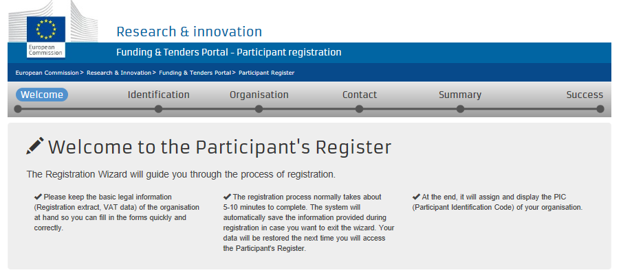
Create a Proposal
Notes:
Before reaching this step 3 you have to go through steps 1 and 2 which is step 1 login in the portal (but you can also search for info without being logged) and step 2 find the call you want to apply. This one is necessary and presented in previous steps.
First note the general screen layout – the information panel on the left, most importantly the call deadline… Underneath that is the « Download Part B » templates – this is where you have to download the application form part B. You can then further work on it, complete it and upload at a subsequent step.
In order to participate you need to register your organisation and obtain a Participant Identification Code (PIC).
If you’ve used the submission system previously, your PIC’s will be presented to you, just click to use that PIC
CLICK. It’s quite possible that your organisation is already registered and you know your PIC, just type the number, or use the search facility (it works like Google). For large corporations you might have already a PIC but not be aware so please do a search first.
CLICK. The most relevant 9 PIC’s will be retrieved, you can click to see more (up to 200)
CLICK. If you still don’t find your PIC then you can register one on-the-fly – at this stage in the process. Just basic information is collected as the legal and financial validation process occurs during the grant preparation phase.
CLICK. Once you’ve chosen your PIC, complete the rest of the information – indicate whether you’re the main contact or not (each participating organisation can have multiple contacts, but must have main contact – these are further defined in the consortium setup (Step 4), a meaningful Acronym for the proposal and a short summary of the proposal – this information is duplicated into the Part A form where is can be updated.

Slide 11
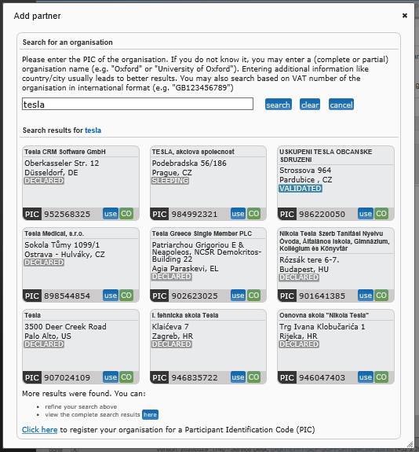
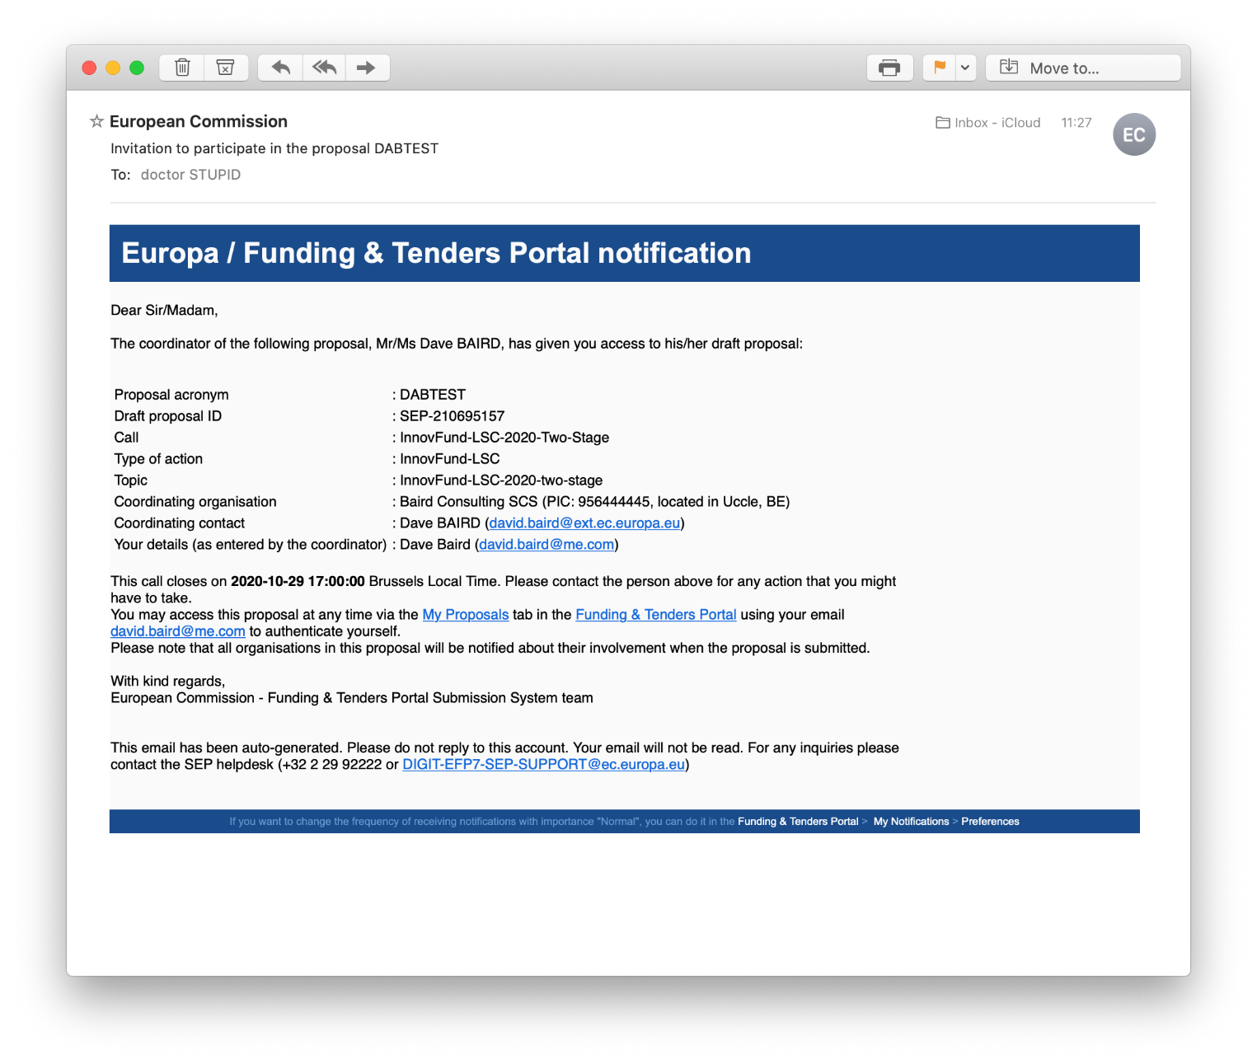
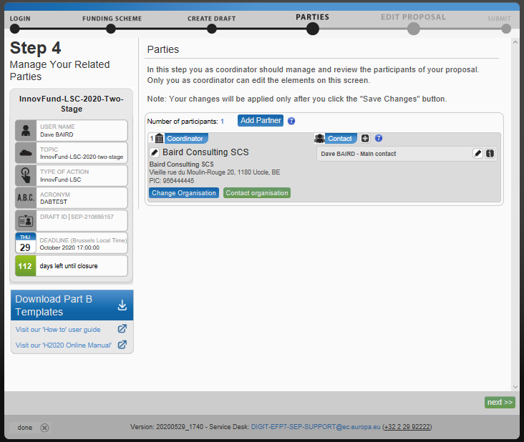
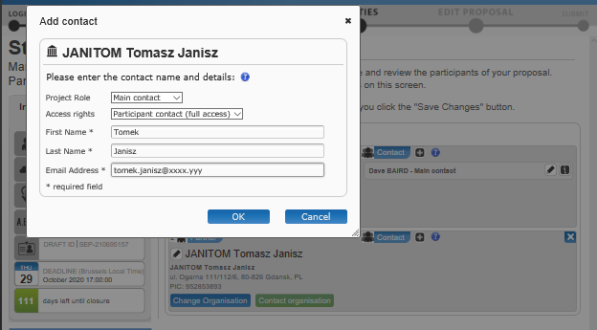
Build a Consortium (if necessary)
Manage Consortium
Notes:
Now you have your draft proposal and you will be able to leave the system and return to update it at any time prior to the deadline, vie the « My Proposals » TAB in the F&TP
In this screen you define and manage the consortium if necessary.
CLICK. You can add and remove partners, as well as changing the order by dragging and dropping
You search for the partner PIC’s in the same way as the Create Proposal step
CLICK. For each partner you must have at least one contact and a main contact
CLICK. When you add the partner to the consortium, you will be prompted to add contact details – the email you enter here is important, it should be the email that the contact uses for EU Login
CLICK. An invitation email will be sent to the email address and the proposal linked to that EU Login account. If this applicant does not have yet an EU login then the email will provide one.
Invited participants will see a link to the proposal in their My Proposals TAB, obviously only if they login with the email address that was used to invite them.
Members of the consortium can view the whole proposal and if allowed by the coordinator can update their organisation details in the Part A form.
The consortium can be edited at any stage of the submission life-cycle, note that if any changes are made then the Part A form (information about all members of the consortium) needs to be re-edited to take into account the changes.
Role of the different members of the consortium: fully left to the applicants to decide. An applicant can operate with sub contractors if he prefers to or include important partners to his project as full partners in the grant. A sub contractor does not sign the grant; a full partner does. Similarly an affiliated entity can be either linked to the project through their sister company or directy sign the grant. Stronger link to the project is full signataire to the grant but freedom of applicants to organise themselves as they like. The role of each partner in the project will be specified in the part B (including of sub contractors); a consortium agreement will need to be signed before the grant is signed. The fact that a project is presented by a single beneficiary or a group of entities is evaluated indirectly under maturity in relation with the implementation team. There is no pre-requisit and a well structured consortium might be as solid as a single entity build project with the support of third parties and sub contractors. Change in consortium between the 2 stages is possible but shuld be justified and not touch the core partners of the project.

Slide 12
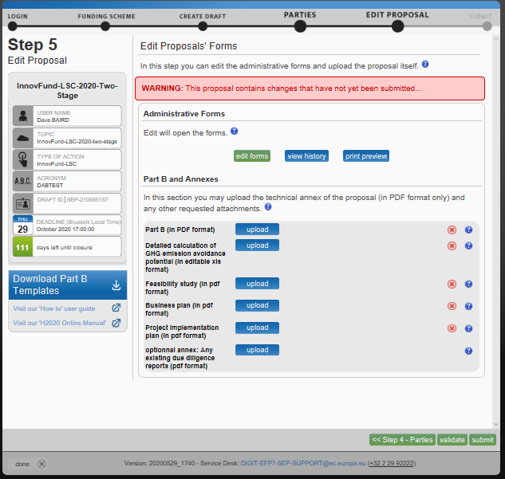
Edit Proposal & Upload Annexes
Notes:
In the Edit Proposal screen the applicants upload their completed annexes (from the download ZIP) and edit the Part A administrative form. As regard the part B which includes the substance of your applicant this is to be downloaded on the left side of the screen. Then filled in and completed (including with other members of the consortium when relevant), and finally uploaded again in this tab.
Please note that the part B is a narrative of your project and the colleagues from CLIMA will go through it in detail. But you also have to reproduce some information from the project in the there (name; summary; partners, etc). Which has to be consistent with what is included in the part A.
The red X indicates that the annexe is mandatory, if you don’t supply a file, you won’t be able to submit.
Files may have both page and size limits. Excess pages are blanked-out and cannot be viewed. Click the « ? » next to each upload slot to check the requirements. If you upload a document with too many pages, you will be shown a warning. However this warning is not blocking the submission.
If you upload a new version of the document it replaces the existing, there are no versions kept and the last uploaded/last submitted is the one that goes forward to evaluation.
Invited contacts from your consortium cannot upload or delete documents here.
Reminder of maximum pages are 40 pages for part B; 25 pages for business plan and implementation plan and 80 pages for feasibility study. Remember that this is a maximum and not a target!! Concise and clear proposals tend to be very appreciated by evaluators. Note the due diligence that can be uploaded if available. If not, you will not be penalised.
Click the « edit forms » to view and edit the Part A administrative form

Slide 13
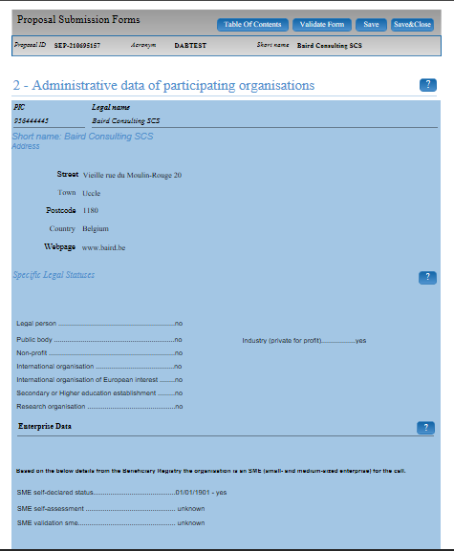
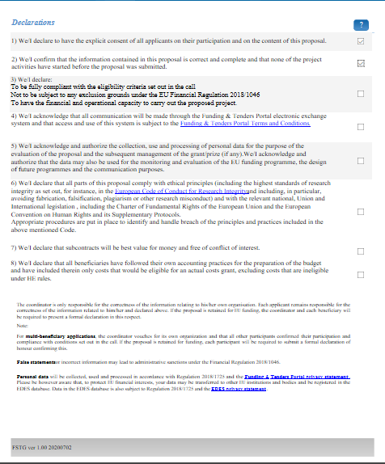
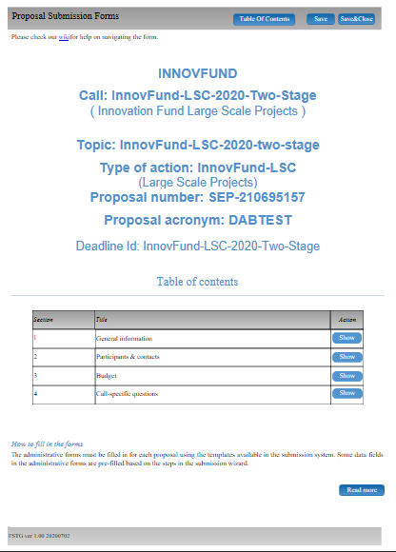
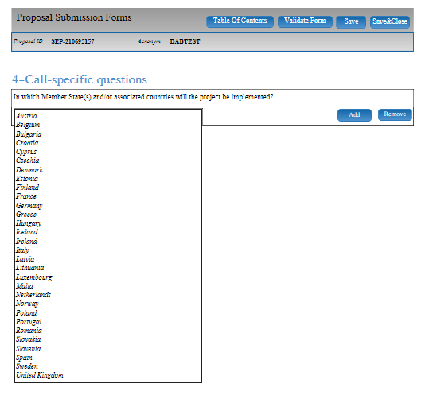
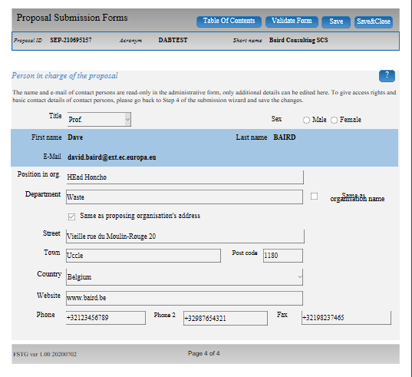
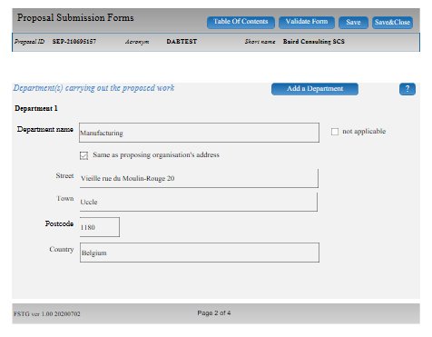
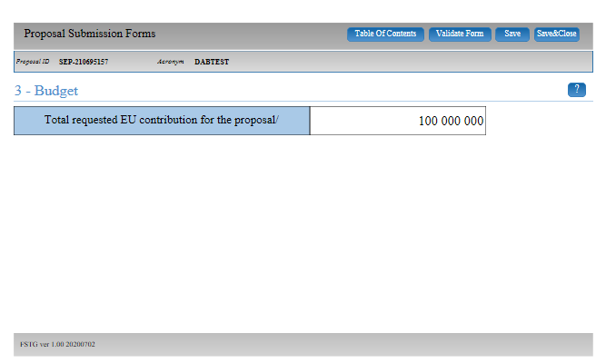
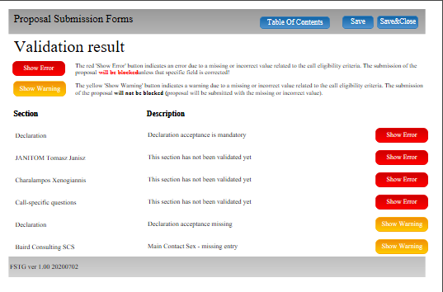
The Part A Structured Form
Notes:
The Part A form needs to be completed – some fields are mandatory (such as the declarations) and if not supplied will block submission
Whenever the consortium is adapted (new partner or removal of a partner), the Part A needs to be updated
CLICK. Be sure to identify your Sector from the keywords in the General information section – yes it’s possible to add more than one sector, but please, do not do it!!!
CLICK. The declarations at this stage are general and similar to all EU funded programmes– there will be a formal declaration of honour during the grant preparation phase for successful proposals.
CLICK. Complete the supplementary contact information. CLICK. For each participant. CLICK. This can also be edited by the organisation themselves, if you allow it.
CLICK. As this is a 1st stage of a 2-stage call, the budget request in the form is a single lump-sum amount. No details or calculation are requested IN THE FORM but the amount must match the numbers presented in the business plan.
CLICK. Be sure to choose the Member State where the project will be implemented. This is an eligibilty condition (only EU + Iceland + Norway). (I note that Associated countries appear in the section but only in the title and the countries are not available in the list-will try to remove this).
CLICK. Click on « Validate Form » to see if you have any missing information – Errors in red will block submission and must be remedied, Warnings in orange will not block submission, but might cause eligibility issues, so recommended to clear these too.

Slide 14
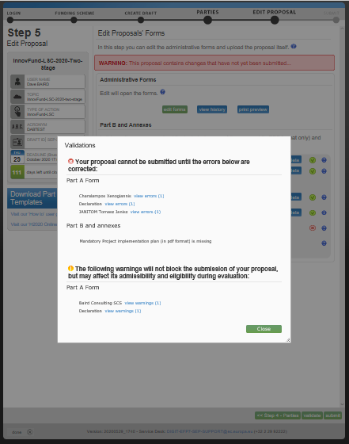
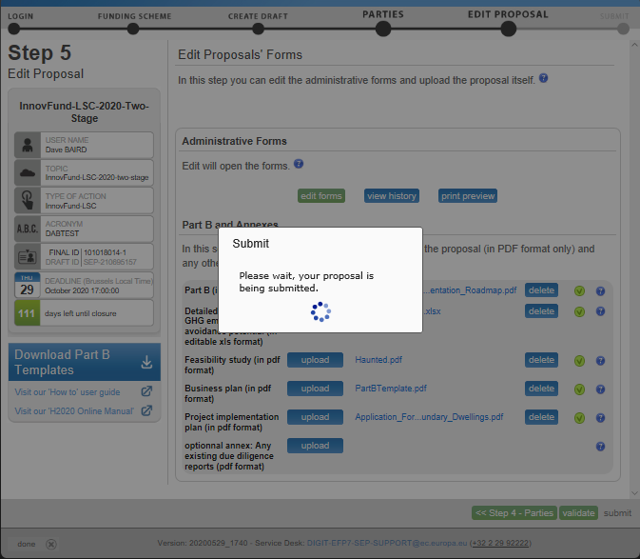
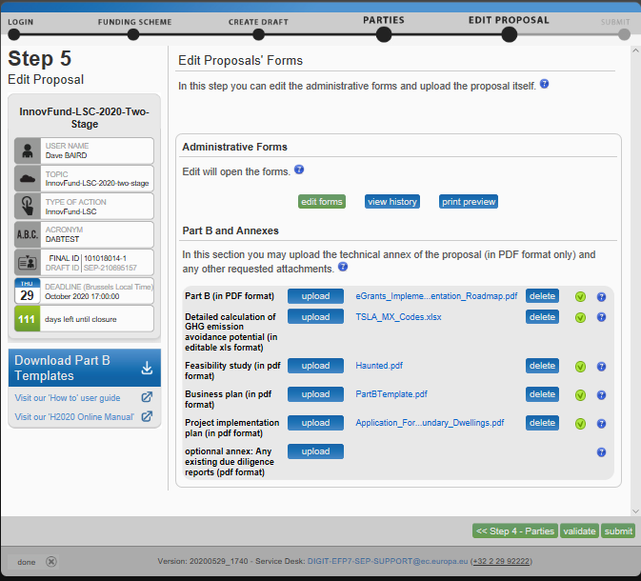
Submitting Your Proposal
Notes:
When everything is completed, you can submit your proposal.
If you have any error conditions (not having ticked a declaration; not having uploaded the part B) you will get a pop-up and can not submit – click the links to go directly into the form to resolve.
CLICK. When all is fine it shows as on the screen.
CLICK. When submitted you receive a confirmation with a « project ID ».
CLICK. This is not actually a project at this stage. CLICK. But the number is retained if the proposal goes forward.
For the second stage, the proposals are created with the content of the 1st stage as a starting point and then you can update the information.
You will receive an email confirming the submission.
After submission you can re-edit the proposal and resubmit as many times as you like prior to the call deadline, note that only submitted changes go forward to evaluation, (i.e. there can be a draft proposal with changes not yet submitted).
You can also download a e-signed copy of the proposal, and you can withdraw the application at any time prior to the call deadline
After the call deadline, the submit button is no longer available and late submission are not accepted. DON’T SUBMIT AT THE LAST MOMENT

Slide 15
My Proposals TAB in the F&T portal
Notes:
Return to your proposal from the My Proposals TAB on F&TP, you need to be logged-in with the correct EU Login account for this. CLICK. Go on actions to reopen the proposal.

Slide 16
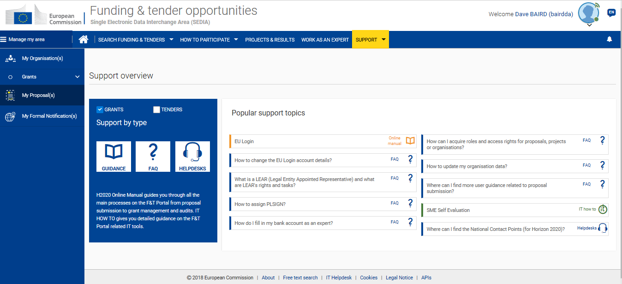
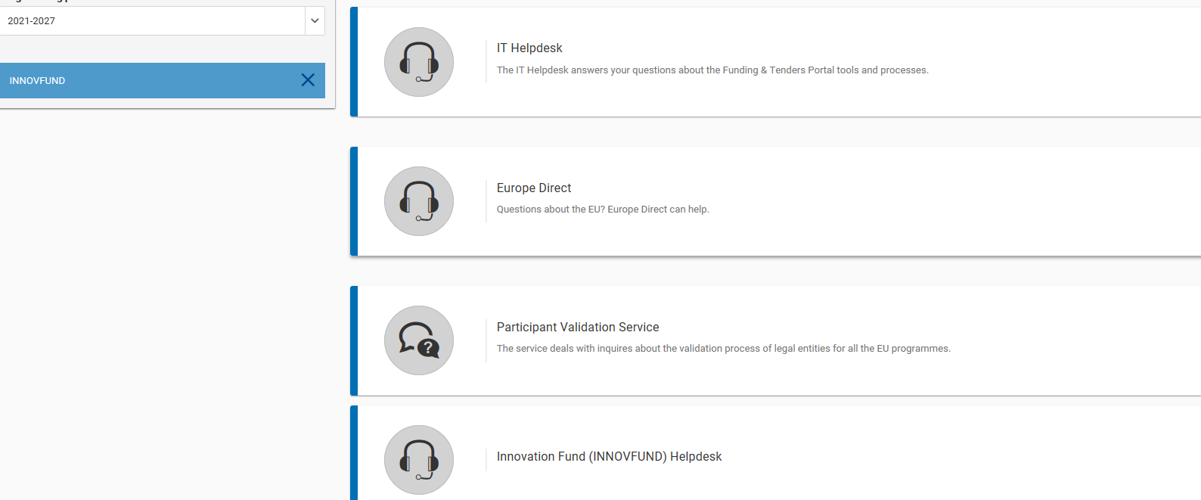
Where to Get Help
Notes:
If you need help… Again, recommened reading the « How to Participate » section on F&TP – there’s a lot of information there
Failing this you can ask a business question via the « Support » section - be sure to select Innovation Fund as the programme so that the request routes to the right people
CLICK. You have the Innovation Fund helpdesk for questions related to the call. These questions will reach INEA. These questions are for instance explanation related to the call text; to the rules applicable. Attention, we cannot advice on the project content or approach!! If questions here are of general interest for all applicants they will be turned into an FAQ and published on the funding tender. Remember that the FAQs can be found in the call page at the bottom of the page.
CLICK. For technical/IT matters we have a dedicated support service that is available on business days 8:00 to 20:00 – the email address and telephone number is at the foot of every screen in the submission system – they are nice people and have heard all the problems before, don’t hesitate to contact them if you’re stuck, if you have problems on the day of the deadline, then call them. If you have a problem to encode information in the part A; to upload a document; to find the right template, etc, this is where you should ask your question.
To conclude: robust IT tool with good guidance and help online. Maybe seems complicated but fairly intuitive when doing it. Encouragements are to test the tool and start preparing your application as soon as possible.
Now DG CLIMA will go in more details in the part B of the application.

Slide 17
Innovation fund call on the funding and tender portal
Thank you!
Contact INEA through the
funding and tender portal helpdesks
@inea_eu
Iwww.ec.europa.eu/inea

