Slide 1
2nd Meeting of the Consultation Forum according to Art. 23 of Regulation (EU) No 517/2014 on fluorinated greenhouse gases Centre Borschette, Brussels, 1 December 2016

Slide 2
Welcome!

Slide 3
Reminder: The Forum`s mission
to provide advice and expertise to the Commission in relation to the implementation of the F-gas Regulation, in particular with regard to the availability of alternatives to fluorinated greenhouse gases, including the environmental, technical, economic and safety aspects of their use.
See Article 23 of the F-gas Regulation

Slide 4
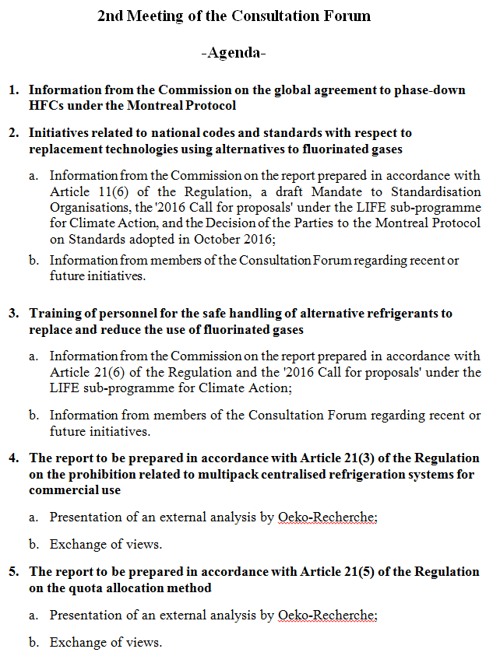

Slide 5
TOPIC 1:

Slide 6
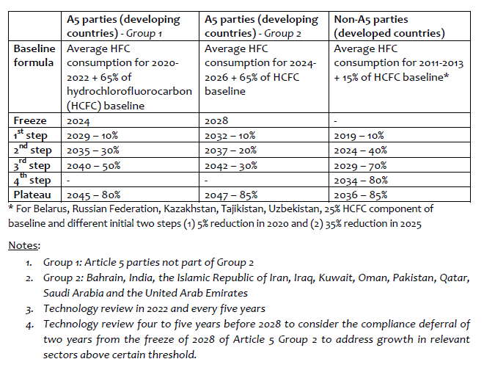

Slide 7
TOPIC 2: Standards

Slide 8
Report according to Article 11(6)
Published yesterday as COM(2016) 749
Standards identified as barriers for the use of flammable refrigerants
to be addressed with urgency (EU strategy on heating and cooling)

Slide 9
Report according to Article 11(6)
There is a need to:
facilitate the update of relevant standards (standardisation organisations, industry, Member States)
collect evidence enabling better risk minimization approaches (companies, researchers)
consider a review of prohibitive national standards (Member States)
Also, green public procurement approaches could help boost the market for alternative technologies

Slide 10
Report according to Article 11(6)
The Commission is envisaging:
A request ("mandate") to the European standardisation organisations in support of updating relevant standards, ensuring a technology neutral and consistent approach.
Facilitating at an international level an exchange of information on standards (Parties to the Montreal Protocol, standardisation bodies, industry as well as other stakeholders)

Slide 11
Status quo of standard setting process
Thierry LeGrand (CEN/CENELEC)

Slide 12
Draft mandate to CEN/CENELEC
Request to assess potential shortcomings and technology related barriers in existing European standards in order to allow a wider use of flammable refrigerants:
Review the existing standards and work programmes, in particular with regard to allowable charge sizes of flammable refrigerants, identifying needs for updates
Propose options for performance based requirements for the use of all flammable substances (based on risk assessments)
Identify new work items, e.g. considering possible risk minimisations, offering flexibility in application of mitigation measures.
Technical report to be submitted within 2 years

Slide 13
Montreal Protocol Decision XXVIII/4: Establishment of regular consultations on safety
Taskforce of technical body TEAP + outside experts
liaise with standard organisations on 60335-240
report on progress, risk assessments, implications for global phase-down
pass relevant findings to standard bodies
Workshop on safety standards
Parties to consult with their industries and standard bodies and submit information by end-2016
Multilateral Fund to help with relations to standard committes at national level
Consider regular consultations with standard bodies

Slide 14
LIFE programme 2016 call for proposals
Demonstration, pilot or best practice projects
to demonstrate how risks of flammable refrigerants, in particular hydrocarbons, are minimized in design and use of equipment to maximize refrigerant charge sizes without compromising safety
Need for objective data:
bringing relevant existing information and research together
new complementary laboratory and field studies in support of standard setting processes and the work of existing standard committees

Slide 15
TOPIC 3: Training

Slide 16
Report according to Article 21(6)
Published yesterday as COM(2016) 748
The legislative framework complemented by existing standards at the European level appears appropriate to assure safe handling of equipment
Further legislative action at EU level on this issue seems therefore not appropriate at this time
Shortcomings were identified in the existing training offer (e.g. training facilities, practical training, number of skilled personnel)

Slide 17
Report according to Article 21(6)
Remedial Actions being taken:
Training was a key priority in LIFE 2016 call
Diverse action by industry associations, private companies and authorities
Further interest for:
Companies selling alternative euqipment
Technician association looking at opportunities for their members
National authorities to use existing funding programmes
To help address shortcomings

Slide 18
LIFE programme 2016 call for proposals
Priority area "Climate Governance and Innovation"
- Activities increasing the uptake of training for service personnel of equipment using climate-friendly alternatives
Awareness campaigns among end-users and the equipment distribution chain to promote training need and exchange of best practices
Train-the-trainer programmes for multiplication of effort and addressing geographic imbalances

Slide 19
TOPIC 4: Commercial Refrigeration

Slide 20
Presentation of an external analysis by Oeko-Recherche

Slide 21
Exchange of Views

Slide 22
TOPIC 5: Quota allocation method

Slide 23
Presentation of an external analysis by Oeko-Recherche

Slide 24
Exchange of Views

Slide 25
Thank you for your participation! Any written contributions please send by 15 December to Clima-Fgas-Consulation-Forum@ec.europa.eu

