Slide 1
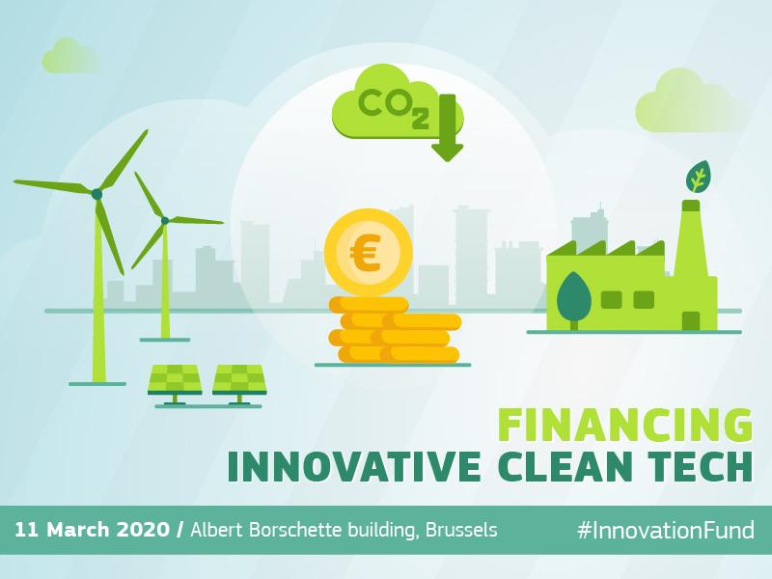
Innovation Fund
Deep dive workshop
Project maturity, scalability and innovation
12 March
Notes:
Welcome and agenda:
Explain agenda and who’s speaking
Mention lunch and coffee breaks

Slide 2
Agenda
09:30 – 09:50 Intro & meeting objectives
16:00 – 17:00
Summary of discussions
17:00 – 17:10 Conclusions and next steps
11:55 – 12:45 Scalability
14:00 – 14:50 Project development assistance
09:50 – 10:40 Degree of innovation
10:40 – 10:50
Break
10:50 – 11:55
Project maturity and due diligence
12:45 – 14:00
Break
14:50 – 15:40 Knowledge sharing
15:40 - 16:00 Break
Notes:
Welcome and agenda:
Explain agenda and who’s speaking
Mention lunch and coffee breaks

Slide 3
Slido
During the event, Slido will be used for:
Short surveys
Submit your questions and comments
TO JOIN:
Take out your smartphone, tablet or computer and open your browser
Go to Slido.com and enter the event code #IFTW.
You can now post comments, like comments and participate in polls.
Identify yourself when posting comments. These comments will be considered with priority.
Notes:
Explain how slido works and that there will be a poll after every section

Slide 4
Innovation Fund Key features
Volume of at least EUR 10 billion until 2030 (at EUR 20 carbon price)
Support of up to 60% of additional costs related to innovative technology
Support of additional capital and operating costs (up to 10 years)
Financed from the revenues of the EU Emissions Trading System
First call in mid-2020 with a volume of EUR 1 billion
Renewable energy
CCS and CCU
Industry
Storage

Slide 5
First-phase selection criteria Expression of interest
GHG emissions avoidance
Degree of innovation
Project maturity
To be delivered during first 10 years of operations (at least 75 %)
Breakthrough technologies
Readiness to invest
1 = feasibility study
100 = "conditional investment decision"
Consistency with 2050 climate-neutrality and EU policies

Slide 6
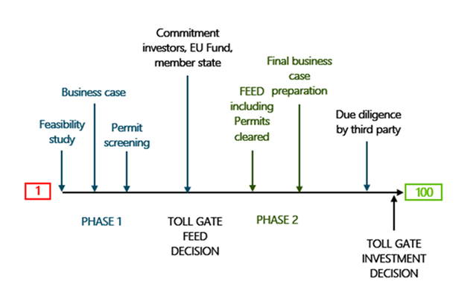
Example for project maturity milestones

Slide 7
Two additional criteria for full application
Scalability
Market potential towards 2050
Expected cost reductions
Resource availabilities
Cost efficiency
Calculation of additional capital and operating expenses
Requested grant in relation to promised GHG emissions avoidance
Number and scale of applications

Slide 8
Principles for design of selection criteria
Close to business
Simple and robust
Due diligence by independent third party
Stay close to an assessment that a CEO or investor would require
Fit for first call
Methodology does not need to be perfect but ready for launch of first call
Apply simple calculation methods with minimum data requirements
Use public data where possible
Can be further developed for later calls

Slide 9
Feedback from last workshop
GHG emissions avoidance
Cost efficiency

Slide 10
GHG emissions avoidance
Renewables
CCS
Energy-intensive industry
ETS benchmark to be outperformed
Refined methodology from NER300, including project related emissions
Energy storage
Most challenging as performance in real life cannot be predicted with certainty
Bonus if project uses additional renewable energy
Additional workshop organised by EASE on 19 March
Calculate GHG emission avoidance instead of energy produced for RES
Which electricity mix emissions to be used? Forecast for EU 2030 emissions gathered most support

Slide 11
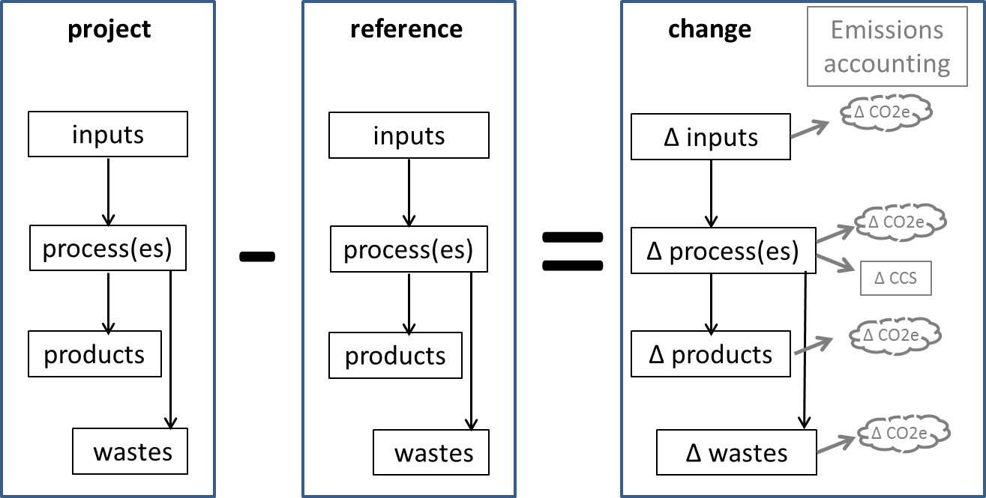
GHG emissions avoidance
ΔEmissions(project) = ΔE(inputs) + ΔE(processes) + ΔE(products) + ΔE(wastes)

Slide 12
Cost calculations
Relevant costs
Benchmark for additionality
Risks
Additional capital expenditure +
To hedge risks, additional costs could be calculated compared to current market and ETS prices
Net present value of additional operating costs and benefits over 10 years after entry into operations
Reference price (e.g. LCOE) in most cases
Risk of lower production in first years could be modelled directly, e.g. through lower production volumes
Reference plant only if reference price is not easily available

Slide 13
Energy intensive industries covered by Annex I of the ETS Directive
Renewable energy
Energy storage
Iron & steel
Non-ferrous metals
Cement & lime
Glass, ceramics & building materials
Pulp & paper
Chemicals
Hydrogen (both blue and green hydrogen)
Other (all projects covered by ETS but cannot be classified in one of the sectors above)
CO2 storage (for projects that aim only to store CO2; CO2 capture will be classified in the respective sectors above)
Wind energy
Solar energy
Hydro/ Ocean energy
Geothermal energy
Bio-Energy
Renewable heating and cooling
Energy storage (a further division into short-term and long-term storage may be envisaged)
Refineries (including bio-refineries)

Slide 14
Updates on governance
Call for expert evaluators
INEA hires
Cooperation with financial sector, investors and consultants

Slide 15
Cooperation with financial sector, investors, and consultants
You bring mature and innovative projects to the Innovation Fund
You work as evaluator for the Innovation Fund
(subject to conflict-of-interest rules)
You help projects to reach financial close within 4 years after award of Innovation Fund grant

Slide 16
Join as project evaluator for 1st and 2nd phase
Individual evaluation – remote phase
Consensus group – central phase (eg in Brussels)
Varied team of experts per proposal
Competitive financial conditions based on expertise
Confidentiality and conflict of interest rules
Apply and share with colleagues!
Register here:
https://ec.europa.eu/info/funding-tenders/opportunities/portal/screen/work-as-an-expert
Mention “Innovation Fund”
Send your CV to INEA-Innovationfund-calls@ec.europa.eu

Slide 17
Conflicts of interests in evaluations
Marc Vanderhaegen
HoU R1 Ressource Unit
Innovation and Network Executive Agency, INEA

Slide 18
Conflicts of interest in evaluations (1)
The quality of the experts and their independence is central to the evaluation process
Conflicts of Interest rules are spelled out in the contract signed by each evaluator. The contract also includes a confidentiality clause
Detection of Conflict of Interest is done through systematic checks by EC services
Detection of Conflict of Interest is also done through self-declaration by evaluators. Evaluators must inform the Agency as soon as they become aware of a potential Conflict of Interest:
Before the signature of the contract
Upon receipt of the proposals, or
During the course of their work.

Slide 19
Conflicts of interest in evaluations (2)
Experts have a Conflict of Interest if:
They were involved in the preparation of the proposal
They stand to benefit directly/indirectly if the proposal is successful or fails
They have a close family/personal relationship with any person representing a participant
They are a director/trustee/partner of an applicant or involved in the management of an applicant's organisation
They are/were employed or contracted by an applicant
They are involved in a competing proposal

Slide 20
Conflicts of interest in evaluations (3)
In the following situations, the Agency will decide whether a Conflict of Interest exists:
The expert was employed by an applicant in the last three years
The expert is in any other situation that casts doubt on his impartiality or that could reasonably appear to do so.
If there is a Conflict of Interest for a certain proposal, the expert cannot evaluate it
Neither individually
Nor in the consensus group
The Agency will determine if there is a Conflict of Interest on a case-by-case basis and decide the course of action to follow

Slide 21
IF jobs at INEA– join us!
General description
Team composed of project managers led by senior experts
Specific expert teams following the covered sectors and based on profiles above
Direct outreach activities, contact with industry and market
Management of project evaluations
Management of grant agreements with selected projects, advise, follow-up, reporting
Key objective: effective management of the project portfolio
OPEN VACANCIES
Background in energy, engineering and innovative technologies in the covered sectors.
Deadline: 27/03
PROJECT MANAGER
SENIOR FINANCIAL EXPERT
Background in project finance, investment banking, financial analysis and risk analysis in the covered sectors.
Deadline: 13/03
HOW TO APPLY
WHEN? VACANCIES NOW OPENED
WHERE?
https://ec.europa.eu/inea/en/mission-objectives/job-opportunities s
https://ec.europa.eu/inea/en/mission-objectives/job-opportunities

Slide 22
To be continued …
Expert Group meeting
May (tbc)
Clean Tech Finance Conference
June (tbc)
Jun-Jul
Launch First Call
Sep-Oct
Submission 1st phase
Training and guidance
Q1 21
Invitation 2nd phase
Q2 21
Submission 2nd phase
Q4 21
Grant Award

Slide 23
Please continue to support us
Give feedback on today's workshop
Next expert group meeting in May (tbc)
What are the criteria that are closest to business but still simple enough to handle for project proponents and evaluators?
Summary from workshops and feedback
Mobilize technical and financial experts
Experts for project evaluation
Project managers at INEA
Discussion of FAQs

